Slide 1

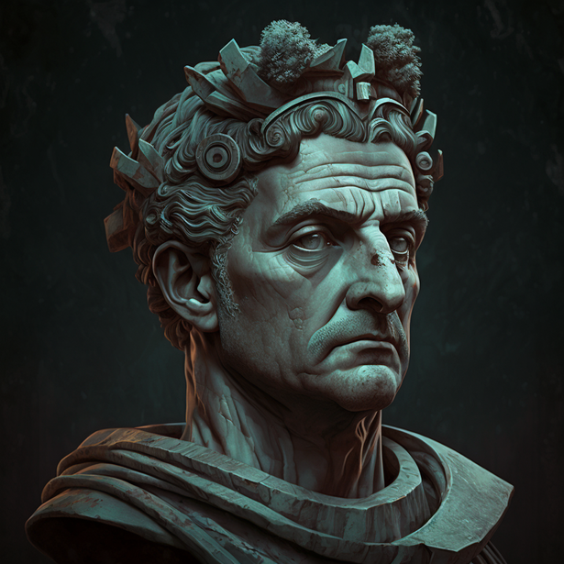

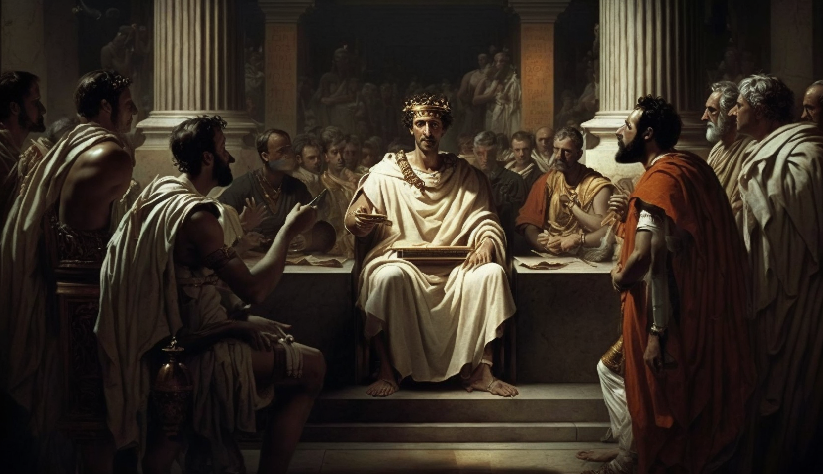
Julius Caesar:
The Roman General Who Shaped History
Julius Caesar was a Roman military general, statesman, and one of the most influential figures in Western history. Born on July 12, 100 BC, in Rome, Caesar played a pivotal role in the transformation of the Roman Republic into the Roman Empire. His exceptional military and political skills allowed him to shape the course of history, but his ambitions eventually led to his downfall.
Early Life: Gaius Julius Caesar was born into a noble family, the Julii, which claimed descent from the goddess Venus. Despite their noble lineage, the Julii were not wealthy or politically influential. As a young man, Caesar received an excellent education, studying subjects like rhetoric, philosophy, and literature. He also had an early introduction to military life, joining the army at the age of 17.
Military Achievements: Julius Caesar was known for his remarkable military prowess. He was responsible for expanding the Roman Republic's territory through a series of successful campaigns. One of his most famous accomplishments was the conquest of Gaul (modern-day France and Belgium) from 58-50 BC. This victory not only secured Rome's northern border but also provided him with the resources and support he needed for his political ambitions.
Civil War and Rise to Power: In 49 BC, Caesar crossed the Rubicon River with his army, igniting a civil war against his rival, Pompey the Great. After defeating Pompey and his supporters, Caesar became the supreme ruler of Rome. He implemented several reforms, such as creating a new calendar, redistributing land to the poor, and reducing government debt. These actions made him popular with the common people but also generated resentment among the Roman elite.
Inquiry Questions:
How did Julius Caesar's early life and upbringing influence his future career?
What factors contributed to Caesar's success in conquering Gaul?
How did Caesar's reforms impact Roman society during his rule?
Why did the Roman elite conspire to assassinate Julius Caesar?
How did Caesar's death lead to the establishment of the Roman Empire?
Assassination: Julius Caesar's growing power and ambition led to his assassination on the Ides of March (March 15), 44 BC. A group of senators, led by Brutus and Cassius, conspired to murder Caesar, fearing he would overthrow the Roman Republic and become a tyrant. His death marked the end of the Roman Republic and the beginning of the Roman Empire.
Did You Know? Julius Caesar is the reason we have the month of July! He reformed the Roman calendar, creating the Julian calendar, which included the month of July, named in his honor.

Slide 2
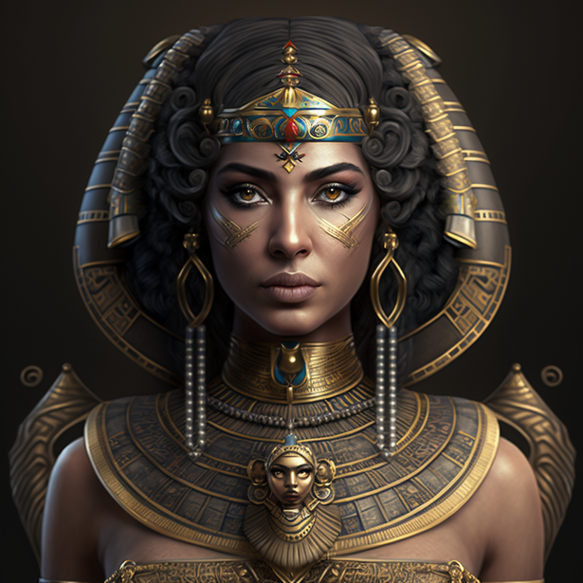
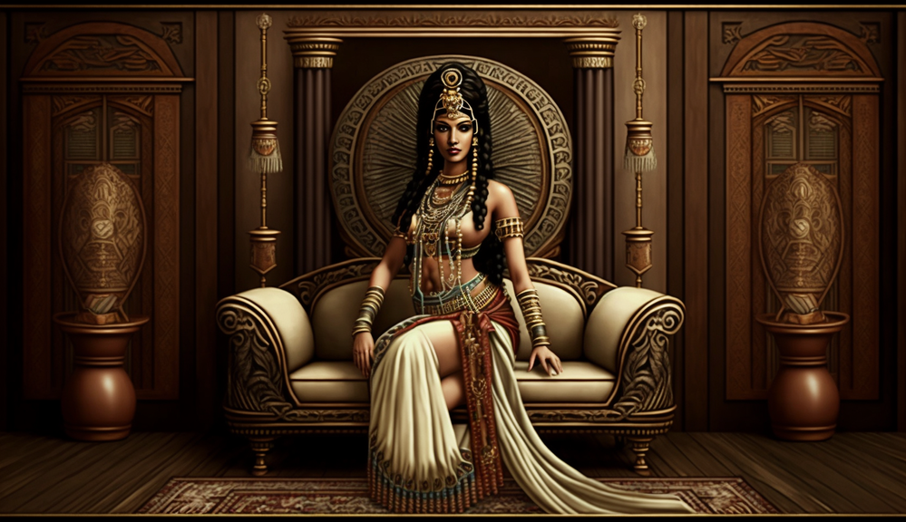
Cleopatra VII:
The Last Pharaoh of Ancient Egypt
Cleopatra VII was the last Pharaoh of Ancient Egypt, reigning from 51-30 BC. A member of the Ptolemaic Dynasty, Cleopatra was known for her intelligence, political savvy, and legendary beauty. Her romantic relationships with Julius Caesar and Mark Antony, as well as her tragic death, have made her an enduring figure in history and popular culture.
Early Life: Cleopatra was born in 69 BC to Ptolemy XII Auletes, a Macedonian Greek who ruled Egypt. As was common in the Ptolemaic Dynasty, she was married to her younger brother, Ptolemy XIII, when she was 18. Cleopatra was well-educated, fluent in several languages, and trained in various subjects like mathematics, philosophy, and astronomy.
Political Struggles and Alliances: Cleopatra's early reign was marked by political turmoil and sibling rivalry. She was temporarily exiled from Egypt but managed to regain power with the help of Julius Caesar, with whom she formed a political alliance and had a son, Caesarion. After Caesar's assassination, Cleopatra aligned herself with Mark Antony, a powerful Roman general, further solidifying her influence in the Eastern Mediterranean.
Death and Legacy: Cleopatra's alliance with Mark Antony ultimately led to her downfall. The Roman leader Octavian declared war on Cleopatra and Antony, defeating them in the Battle of Actium in 31 BC. Facing capture and humiliation, Cleopatra died by suicide, reportedly by allowing an asp (Egyptian cobra) to bite her. Her death marked the end of the Ptolemaic Dynasty and the beginning of Roman rule in Egypt.
Inquiry Questions:
How did Cleopatra's education and upbringing prepare her for leadership?
In what ways did Cleopatra's relationships with Julius Caesar and Mark Antony influence her political decisions?
What challenges did Cleopatra face during her reign, and how did she overcome them?
How did Cleopatra's rule impact Egypt's relationship with Rome?
What factors contributed to Cleopatra's enduring legacy in history and popular culture?
Did You Know? Cleopatra was not Egyptian by blood. She was of Greek descent, belonging to the Ptolemaic Dynasty that was established after the death of Alexander the Great.

Slide 3

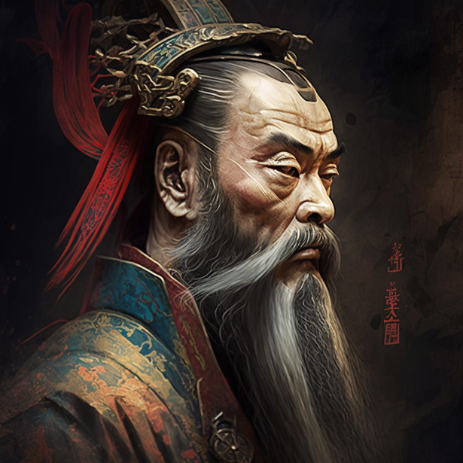
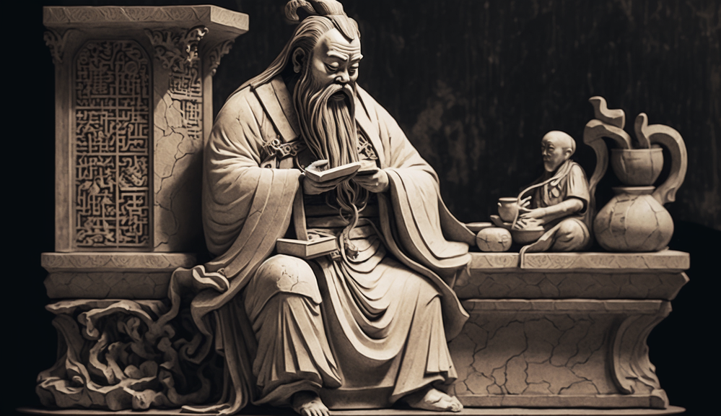
Confucius:
The Great Chinese Philosopher and Teacher
Confucius, born in 551 BC, was a Chinese philosopher, teacher, and political figure who greatly influenced Chinese thought and culture. His teachings, which emphasize moral values, family relationships, and social harmony, have been a guiding force in China and other East Asian countries for over two thousand years.
Early Life: Confucius was born in the state of Lu (now part of Shandong Province) during the Spring and Autumn period of Chinese history. His family was of noble descent but had fallen on hard times. Confucius was raised in poverty by his widowed mother and was largely self-taught. Despite his difficult upbringing, Confucius developed a passion for learning, studying history, poetry, and music.
Teachings and Philosophy: Confucius believed that a harmonious and stable society could be achieved through the cultivation of moral virtues and the adherence to proper rituals. His teachings emphasized the importance of filial piety (respect for one's parents), loyalty to one's ruler, and the practice of benevolence (kindness and compassion) towards others. Confucius also advocated for the concept of the "superior man" or "junzi," an individual who leads by example and strives for moral excellence.
Career and Influence: Confucius traveled throughout China, teaching and advising rulers on governance and moral principles. However, he often struggled to find rulers who would implement his ideas. In his later years, Confucius returned to his home state of Lu and focused on teaching a group of devoted disciples. His students compiled his teachings into a collection of texts known as the "Analects," which became the foundation of Confucianism.
Inquiry Questions:
How did Confucius' early life experiences influence his teachings and philosophy?
What are the key principles and values emphasized in Confucianism?
How did Confucius' teachings impact Chinese society and government during his lifetime?
What factors contributed to the spread and enduring influence of Confucianism?
How has Confucianism shaped the culture and values of East Asian societies?
Did You Know? Confucius' teachings have had a lasting impact on East Asian culture, shaping the education system, social behavior, and even art and literature.

Slide 4
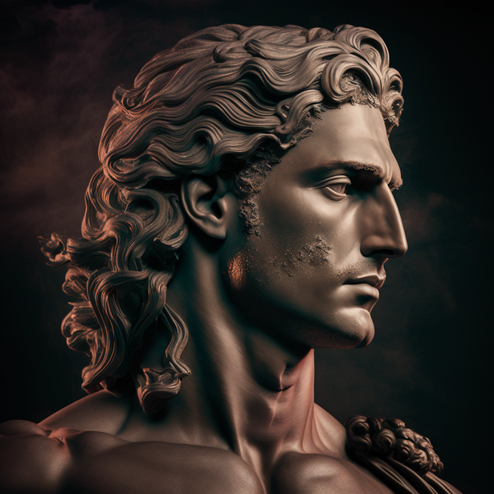
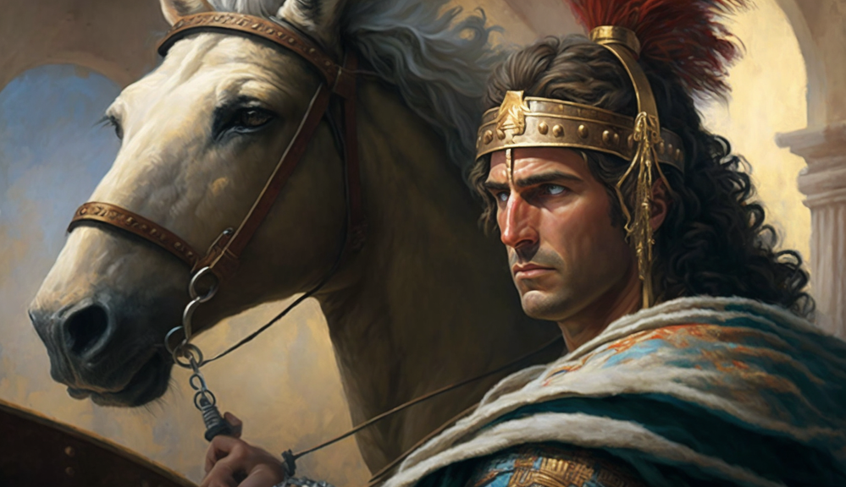
Alexander the Great:
The Conqueror Who United an Empire
Alexander the Great, born in 356 BC, was the King of Macedon and one of history's most successful military commanders. His conquests across Asia, Europe, and Africa created one of the largest empires in the ancient world. Alexander's military genius and charismatic leadership have made him a legendary figure in both Eastern and Western history.
Early Life: Born in Pella, the ancient capital of Macedon, Alexander was the son of King Philip II and Queen Olympias. He was tutored by the great philosopher Aristotle, who provided him with an exceptional education in subjects such as literature, science, and politics. Alexander also displayed remarkable military talent from an early age, joining his father's army at just 16 years old.
Conquests and Empire Building: After the assassination of his father in 336 BC, Alexander ascended to the Macedonian throne and quickly set out to expand his kingdom. Over the next 13 years, he embarked on an unparalleled military campaign, conquering the Persian Empire, Egypt, and parts of modern-day India. Alexander's empire stretched over 3,000 miles, from Greece in the west to the Indus River in the east.
Cultural Exchange and Legacy: Alexander's conquests not only expanded his empire but also facilitated cultural exchange between the East and West. He established numerous cities, including Alexandria in Egypt, which became centers of learning, trade, and Hellenistic culture. Alexander's death in 323 BC marked the end of his reign, but his influence continued to shape the course of history for centuries.
Inquiry Questions:
How did Alexander's education and upbringing shape his skills as a military leader and ruler?
What strategies and tactics contributed to Alexander's success on the battlefield?
How did Alexander's empire facilitate cultural exchange between the East and West?
What challenges did Alexander face during his conquests, and how did he overcome them?
How has Alexander the Great's legacy influenced the course of Western and Eastern history?
Did You Know? Alexander the Great named more than 70 cities after himself and one after his beloved horse, Bucephalus.

Slide 5
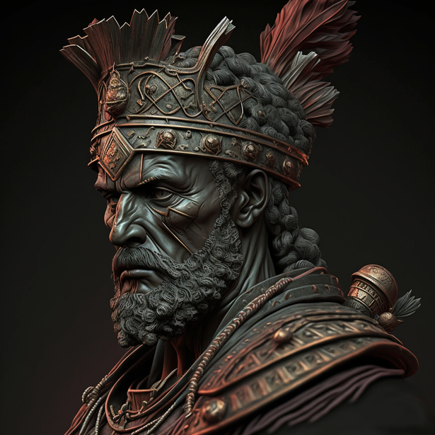
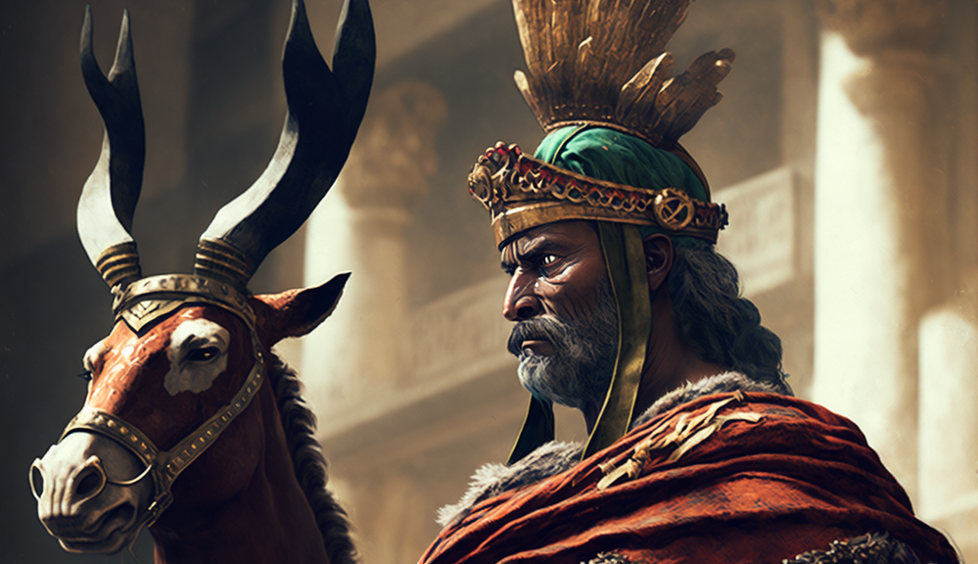
Hannibal Barca:
The Fearless Carthaginian General
Hannibal Barca (247-183 BC) was a Carthaginian general and statesman known for his strategic genius and daring military tactics. As one of the greatest military commanders in history, Hannibal's campaigns against Rome during the Second Punic War (218-201 BC) are legendary, particularly for his daring crossing of the Alps with his army and war elephants.
Early Life: Hannibal was born into a prominent military family in Carthage, a powerful city-state located in modern-day Tunisia. His father, Hamilcar Barca, was a distinguished general who fought in the First Punic War against Rome. From an early age, Hannibal accompanied his father on military campaigns, learning the art of war and developing a deep-seated hatred for Rome.
Second Punic War and Military Achievements: Hannibal is best known for his campaigns against Rome during the Second Punic War. In 218 BC, he embarked on a daring campaign to invade Italy by crossing the Alps with his army, which included war elephants. Despite harsh weather and difficult terrain, Hannibal successfully led his troops into Italy, where he won several major battles, including the Battle of Cannae in 216 BC.
Defeat and Later Life: Although Hannibal achieved significant victories against Rome, he was ultimately unable to conquer the city itself. In 202 BC, he was defeated by the Roman general Scipio Africanus at the Battle of Zama, which marked the end of the Second Punic War. Hannibal returned to Carthage, where he continued to serve his city as a statesman. However, he was eventually forced into exile and committed suicide in 183 BC to avoid capture by his Roman enemies.
Inquiry Questions:
How did Hannibal's upbringing and family background influence his military career and hatred of Rome?
What strategies and tactics did Hannibal employ during the Second Punic War to achieve success against the Romans?
How did Hannibal's crossing of the Alps impact the course of the Second Punic War?
What challenges did Hannibal face during his campaigns, and how did he overcome them?
How has Hannibal's legacy as a military commander influenced the study and practice of warfare throughout history?
Did You Know? Hannibal's crossing of the Alps with his army and war elephants is considered one of the most remarkable military achievements in history.

Slide 6
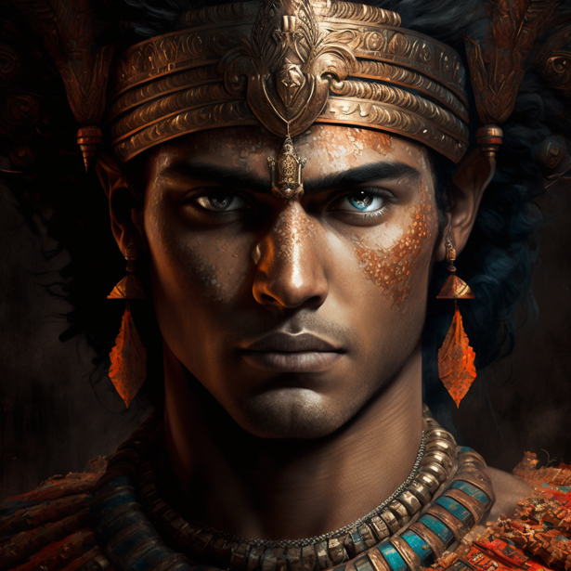
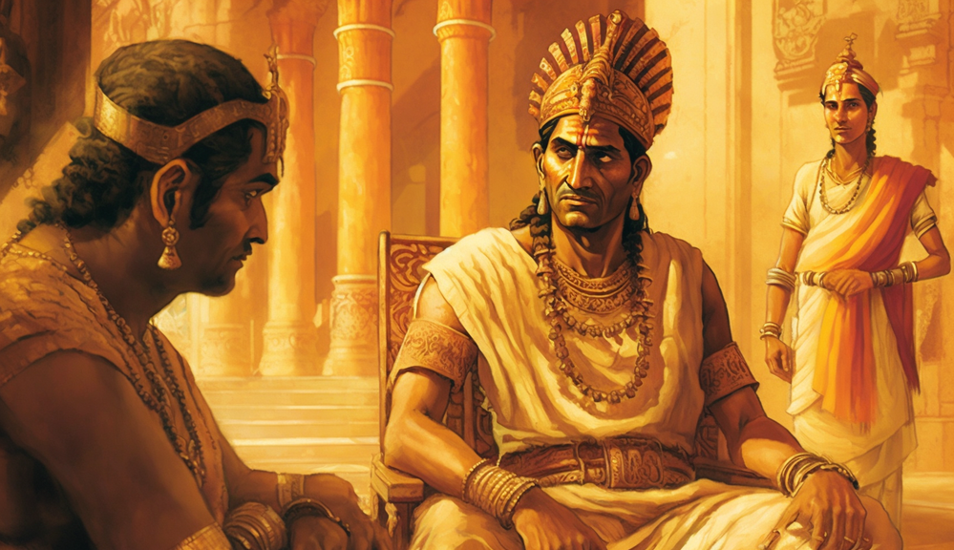
Ashoka the Great:
The Enlightened Emperor of India
Ashoka the Great (304-232 BC) was an Indian emperor of the Maurya Dynasty, known for his benevolent rule, promotion of Buddhism, and the establishment of the first unified empire in the Indian subcontinent. His reign marked a significant period of political unity, cultural growth, and the spread of Buddhism throughout Asia.
Early Life and Ascension to Power: Ashoka was born into the Mauryan royal family, the grandson of Chandragupta Maurya, the founder of the Maurya Dynasty. As a young prince, Ashoka was educated in various subjects, including military strategy, statecraft, and the arts. He ascended to the throne in 269 BC, following the death of his father, Bindusara, and a period of power struggle among his siblings.
Conquest and Transformation: Early in his reign, Ashoka expanded his empire through military conquests, with his most notable victory occurring in the bloody Kalinga War in 261 BC. However, the immense suffering and loss of life caused by the war deeply affected Ashoka, leading to a dramatic change in his worldview. He embraced Buddhism, adopting its principles of nonviolence, compassion, and moral conduct as guiding principles for his rule.
Benevolent Rule and Promotion of Buddhism: Ashoka's reign was marked by a focus on social welfare, religious tolerance, and the promotion of Buddhism. He constructed hospitals, rest houses, and edicts inscribed on rocks and pillars throughout his empire, sharing his beliefs and moral guidance with his subjects. Ashoka sent Buddhist missionaries to spread the religion across Asia, significantly influencing the religious landscape of the continent.
Inquiry Questions:
How did Ashoka's early life and education prepare him for his role as an emperor?
In what ways did Ashoka's transformation after the Kalinga War influence his rule and policies?
What measures did Ashoka take to promote social welfare, religious tolerance, and Buddhism in his empire?
How did Ashoka's reign contribute to the unification and cultural growth of the Indian subcontinent?
What factors contributed to Ashoka's enduring legacy as a benevolent and enlightened ruler?
Did You Know? Ashoka's inscriptions, known as the "Edicts of Ashoka," provide valuable insights into his reign, beliefs, and the social conditions of ancient India.

Slide 7


Joan of Arc:
The Inspirational Heroine of France
Joan of Arc (1412-1431) was a French peasant girl who became a national heroine and saint for her role in turning the tide of the Hundred Years' War in favor of France. Guided by what she believed were divine visions, Joan led French forces to key victories over the English, inspiring her compatriots and becoming a symbol of French resistance.
Early Life and Visions: Joan was born in Domrémy, a small village in northeastern France, to a peasant family during a time of political turmoil and conflict between England and France. At the age of 12, Joan began experiencing visions of saints and angels who urged her to save France from English rule and help crown the rightful king, Charles VII.
Military Leadership and Success: In 1429, at the age of 17, Joan managed to convince the French royal court of her divine mission and was allowed to lead an army to relieve the besieged city of Orleans. Wearing armor and riding a white horse, she led the French forces to a stunning victory, paving the way for the coronation of Charles VII in Reims later that year.
Capture, Trial, and Execution: Joan's military successes made her a target for the English, who eventually captured her in 1430. She was handed over to the English-aligned Bishop of Beauvais, Pierre Cauchon, and put on trial for heresy and witchcraft. Despite her spirited defense, she was found guilty and burned at the stake in 1431, at the age of 19.
Inquiry Questions:
How did Joan of Arc's visions and beliefs influence her actions and decisions during the Hundred Years' War?
In what ways did Joan's leadership and military victories impact the course of the conflict between France and England?
What challenges did Joan of Arc face as a young, female military leader in a male-dominated society?
How did the trial and execution of Joan of Arc reflect the political and religious tensions of her time?
What factors have contributed to Joan of Arc's enduring legacy as a national heroine and saint?
Did You Know? Joan of Arc was canonized as a saint by the Roman Catholic Church in 1920, nearly 500 years after her death.

Slide 8
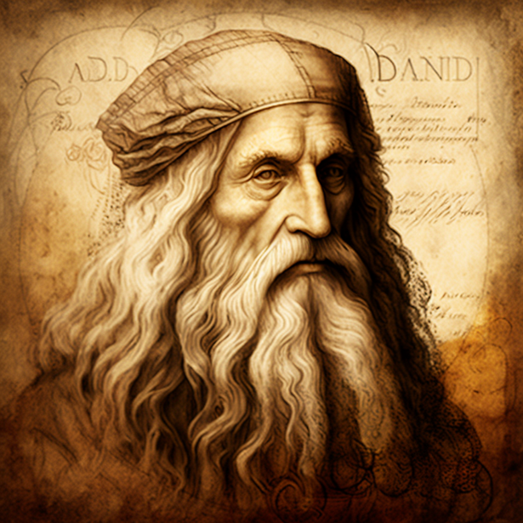
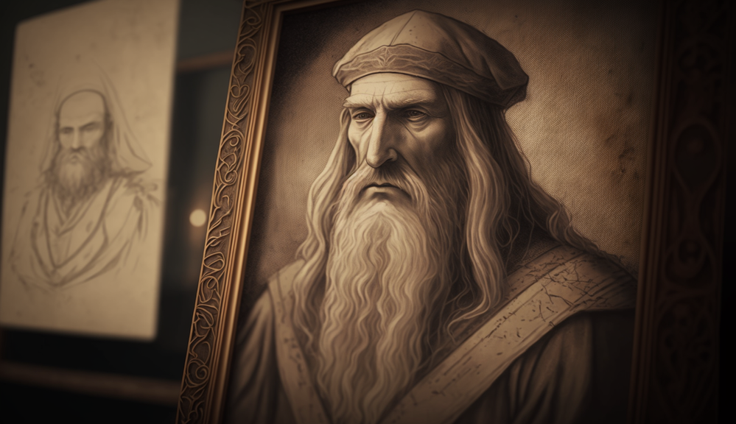
Leonardo da Vinci: The Quintessential Renaissance Man
Leonardo da Vinci (1452-1519) was an Italian polymath who made significant contributions to art, science, and technology during the Renaissance. Known for his artistic masterpieces like the Mona Lisa and The Last Supper, as well as his scientific and engineering ideas, Leonardo is considered one of history's greatest creative minds.
Early Life and Artistic Training: Born in Vinci, a small town near Florence, Italy, Leonardo was the illegitimate son of a notary and a peasant woman. He showed exceptional artistic talent from a young age and, at 14, began an apprenticeship with the renowned Florentine painter Andrea del Verrocchio. Leonardo's time with Verrocchio provided him with a solid foundation in painting, sculpture, and various technical skills.
Artistic Achievements: Leonardo's artistic achievements are numerous and include iconic works such as the Mona Lisa, The Last Supper, and the Vitruvian Man. His paintings are characterized by their use of sfumato (a technique that softens the transition between colors) and his detailed observations of the natural world. Leonardo's innovative approach to art also extended to his anatomical drawings and studies of human proportions.
Scientific and Engineering Ideas: Leonardo's interests extended far beyond the realm of art. He was an avid observer and inventor, producing sketches and detailed notes on a wide range of subjects, including anatomy, botany, engineering, and even flight. His numerous inventions and ideas, such as the flying machine, armored car, and a machine for measuring the strength of materials, were far ahead of their time.
Inquiry Questions:
How did Leonardo da Vinci's artistic training and early experiences shape his approach to art and science?
What innovations and techniques did Leonardo introduce in his paintings and artistic studies?
In what ways did Leonardo's scientific and engineering ideas demonstrate his forward-thinking and inventive spirit?
How did Leonardo's broad range of interests and talents exemplify the ideals of the Renaissance?
What factors have contributed to Leonardo da Vinci's enduring legacy as a polymath and creative genius?
Did You Know? Leonardo da Vinci's notebooks, filled with thousands of pages of sketches, notes, and ideas, provide a unique window into his brilliant and curious mind.

Slide 9
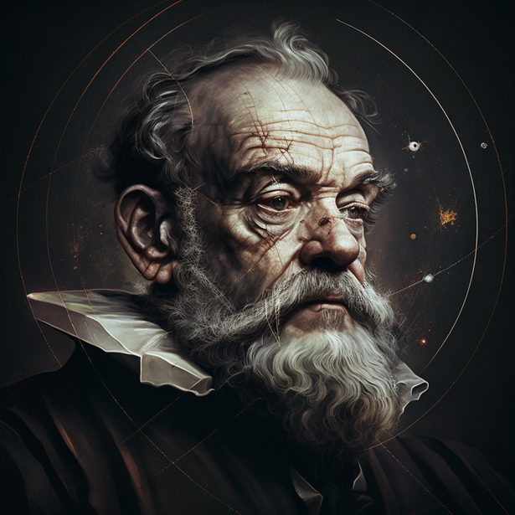

Galileo Galilei:
The Father of Modern Science
Galileo Galilei (1564-1642) was an Italian astronomer, physicist, and mathematician whose groundbreaking discoveries and ideas laid the foundation for modern science. His work on the laws of motion, improvements to the telescope, and support for the heliocentric model of the universe challenged conventional beliefs and helped usher in a new era of scientific inquiry.
Early Life and Education: Galileo was born in Pisa, Italy, into a family with a strong musical and mathematical background. He initially studied medicine at the University of Pisa but soon developed a passion for mathematics and natural philosophy. Galileo's interest in these subjects led him to explore a wide range of scientific topics, including the motion of objects, the properties of materials, and the nature of the universe.
Astronomical Discoveries: Galileo's improvements to the telescope allowed him to make several important astronomical discoveries. He observed the moons of Jupiter, the phases of Venus, and the craters and mountains on the Moon's surface. These observations provided evidence in support of the heliocentric model, which posited that the Earth and other planets revolve around the Sun.
Conflict with the Catholic Church: Galileo's support for the heliocentric model brought him into conflict with the Catholic Church, which adhered to the geocentric model that placed the Earth at the center of the universe. In 1633, Galileo was tried by the Inquisition and found guilty of heresy. He was placed under house arrest for the remainder of his life, during which he continued his scientific work and writing.
Inquiry Questions:
How did Galileo's education and interests lay the groundwork for his scientific discoveries and contributions?
What were some of Galileo's most important astronomical discoveries, and how did they challenge conventional beliefs?
How did Galileo's work on the laws of motion and properties of materials contribute to the development of modern physics?
What factors led to Galileo's conflict with the Catholic Church, and how did this affect his life and work?
How has Galileo's legacy as the "Father of Modern Science" influenced the development and practice of science throughout history?
Did You Know? Galileo is often credited with inventing the telescope, but he actually improved upon existing designs, making them more powerful and suitable for astronomical observation.

Slide 10


Isaac Newton:
The Revolutionary Physicist and Mathematician
Isaac Newton (1642-1727) was an English physicist, mathematician, and astronomer who made groundbreaking contributions to science and mathematics. His development of calculus, formulation of the laws of motion, and theory of universal gravitation have had a profound and lasting impact on our understanding of the natural world.
Early Life and Education: Newton was born in Woolsthorpe, England, to a farming family. He displayed an aptitude for mathematics and science from an early age and went on to study at Trinity College, Cambridge. It was during his time at Cambridge that Newton began to develop his revolutionary ideas in mathematics, physics, and astronomy.
Mathematical Discoveries: One of Newton's most significant achievements was the development of calculus, a branch of mathematics dealing with change and motion. Although the German mathematician Gottfried Wilhelm Leibniz independently developed calculus around the same time, both Newton and Leibniz are credited with its invention. Calculus has become an essential tool in many areas of science, engineering, and economics.
Laws of Motion and Universal Gravitation: Newton's work in physics led to the formulation of his three laws of motion, which describe the relationship between the motion of an object and the forces acting upon it. He also developed the law of universal gravitation, which states that every particle in the universe attracts every other particle with a force that is proportional to the product of their masses and inversely proportional to the square of the distance between them.
Inquiry Questions:
How did Newton's early life and education contribute to his development as a scientist and mathematician?
In what ways did Newton's development of calculus revolutionize mathematics and its applications?
How did Newton's laws of motion and theory of universal gravitation impact our understanding of the natural world?
What challenges and controversies did Newton face during his career, particularly concerning the development of calculus?
How has Isaac Newton's legacy influenced the fields of physics, mathematics, and astronomy throughout history?
Did You Know? Newton's work in physics and mathematics was published in his groundbreaking book, "Philosophiæ Naturalis Principia Mathematica," often referred to simply as the "Principia."

Slide 11
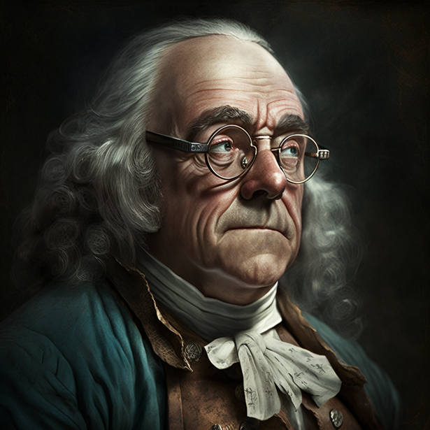

Benjamin Franklin:
The American Polymath and Founding Father
Benjamin Franklin (1706-1790) was an American polymath, statesman, and one of the Founding Fathers of the United States. He made significant contributions to science, literature, and politics and played a key role in shaping the foundations of the United States.
Early Life and Career: Franklin was born in Boston, Massachusetts, to a large, working-class family. He showed a strong aptitude for reading and writing from an early age and eventually became an accomplished printer, writer, and publisher. Franklin's keen intellect and wide-ranging interests led him to explore various fields, including science, politics, and public service.
Scientific Contributions: Franklin's most famous scientific contributions are in the field of electricity. His experiments with electricity led to the invention of the lightning rod, which protects buildings from lightning damage. Franklin also made discoveries in other areas of science, such as meteorology, oceanography, and even the common cold.
Political and Diplomatic Career: As a statesman, Franklin played a pivotal role in the founding of the United States. He was a member of the committee that drafted the Declaration of Independence and later served as the U.S. ambassador to France, helping to secure French support during the American Revolution. Franklin was also a strong advocate for colonial unity and participated in the drafting of the U.S. Constitution.
Inquiry Questions:
How did Benjamin Franklin's early life and career in printing and publishing shape his later achievements in science and politics?
What were some of Franklin's most important scientific discoveries and inventions, and how have they impacted society?
How did Franklin's political and diplomatic efforts contribute to the founding of the United States and the development of its government?
What role did Franklin play in promoting education, public service, and civic improvement in colonial America?
How has Benjamin Franklin's legacy as a polymath and Founding Father influenced American culture and values throughout history?
Did You Know? Benjamin Franklin is the only Founding Father to have signed all four of the major documents that established the United States: the Declaration of Independence, the Treaty of Paris, the Treaty of Alliance with France, and the U.S. Constitution.

Slide 12
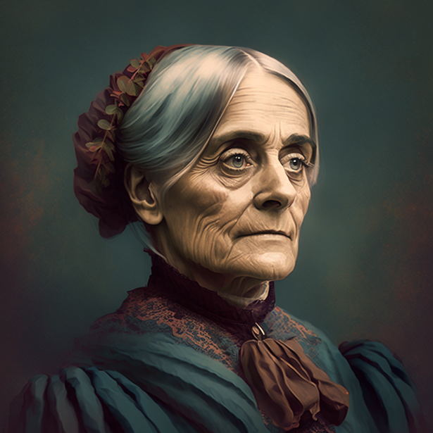
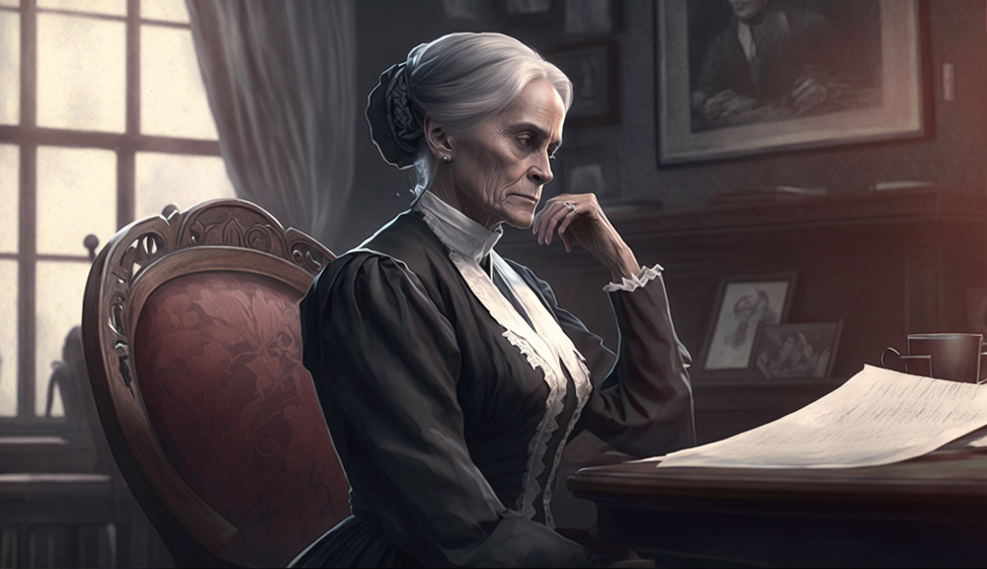
Susan B. Anthony:
The Trailblazing Advocate for Women's Rights
Susan B. Anthony (1820-1906) was an American social reformer and women's rights activist who played a pivotal role in the women's suffrage movement. Her tireless work to secure the right to vote for women in the United States laid the foundation for the eventual passage of the 19th Amendment.
Early Life and Social Reform: Anthony was born in Adams, Massachusetts, to a Quaker family that valued education and social reform. As a young woman, she became involved in various reform movements, including temperance and the abolition of slavery. These early experiences would inspire her lifelong commitment to women's rights and social justice.
Women's Rights and Suffrage Movement: In the early 1850s, Anthony joined forces with Elizabeth Cady Stanton, another prominent women's rights activist. Together, they formed various organizations, such as the Women's Loyal National League and the National Woman Suffrage Association, to promote women's rights, particularly the right to vote. Anthony also traveled extensively, giving speeches and organizing conventions to raise awareness and support for the cause.
Arrest and Trial for Voting: In 1872, Anthony was arrested for voting in the presidential election, an act that was illegal for women at the time. Her highly publicized trial brought national attention to the women's suffrage movement and further galvanized support for the cause. Although Anthony was found guilty and fined, she never paid the fine and continued her activism.
Inquiry Questions:
How did Susan B. Anthony's upbringing and early involvement in social reform movements shape her commitment to women's rights?
In what ways did Anthony's collaboration with Elizabeth Cady Stanton advance the cause of women's suffrage in the United States?
What strategies and methods did Anthony employ to raise awareness and support for women's rights and suffrage?
How did Anthony's arrest and trial for voting impact the women's suffrage movement and public opinion on the issue?
How has Susan B. Anthony's legacy as a trailblazing advocate for women's rights influenced the ongoing fight for gender equality and social justice?
Did You Know? Susan B. Anthony and Elizabeth Cady Stanton published a weekly newspaper called "The Revolution," which focused on women's rights and social reform issues.

Slide 13
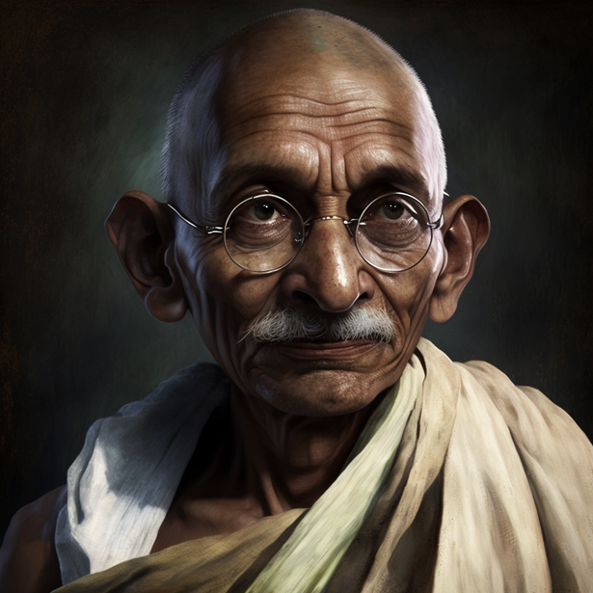
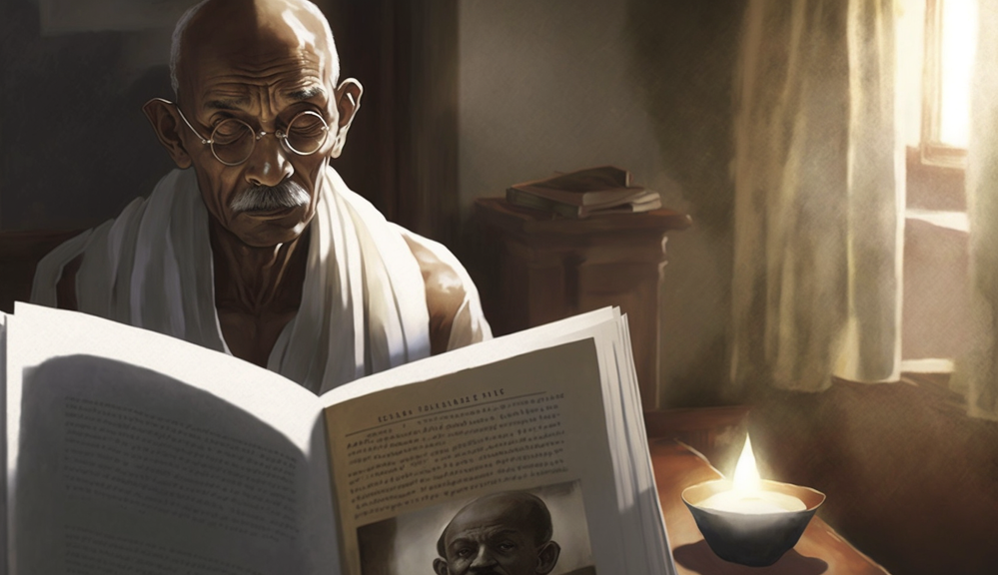
Mahatma Gandhi:
The Inspirational Leader of Indian Independence
Mahatma Gandhi (1869-1948) was an Indian leader and independence activist who employed nonviolent civil disobedience to help India achieve independence from British rule. His philosophy of nonviolence and passive resistance inspired civil rights and freedom movements around the world.
Early Life and Legal Career: Gandhi was born in Porbandar, India, in a middle-class Hindu family. He went on to study law in England and later worked as a lawyer in South Africa. It was during his time in South Africa that Gandhi experienced racial discrimination firsthand, igniting his passion for social justice and equality.
Nonviolent Resistance and Indian Independence Movement: In 1915, Gandhi returned to India and became a leader in the Indian National Congress, advocating for Indian independence from British rule. He developed the concept of "satyagraha," or nonviolent resistance, which involved peaceful protests, boycotts, and noncooperation with British authorities. Gandhi's leadership in events such as the Salt March and the Quit India Movement helped galvanize the Indian population in their quest for independence.
Influence on Global Civil Rights Movements: Gandhi's philosophy of nonviolence and passive resistance had a profound impact on civil rights movements around the world. Notably, Martin Luther King Jr. drew inspiration from Gandhi's ideas in his fight for racial equality in the United States.
Inquiry Questions:
How did Mahatma Gandhi's early life experiences and legal career shape his commitment to social justice and equality?
What principles and methods did Gandhi use to promote nonviolent resistance in the Indian independence movement?
How did Gandhi's leadership in key events, such as the Salt March and the Quit India Movement, contribute to India's eventual independence from British rule?
In what ways has Gandhi's philosophy of nonviolence and passive resistance influenced civil rights and freedom movements around the world?
How has Mahatma Gandhi's legacy as an inspirational leader for social change endured throughout history?
Did You Know? Mahatma Gandhi's real name was Mohandas Karamchand Gandhi. "Mahatma" is an honorific title meaning "great soul" in Sanskrit.

Slide 14
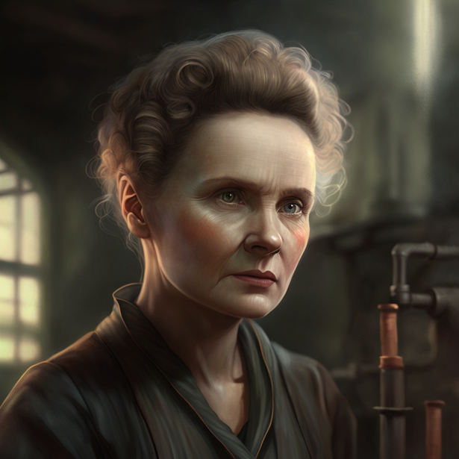
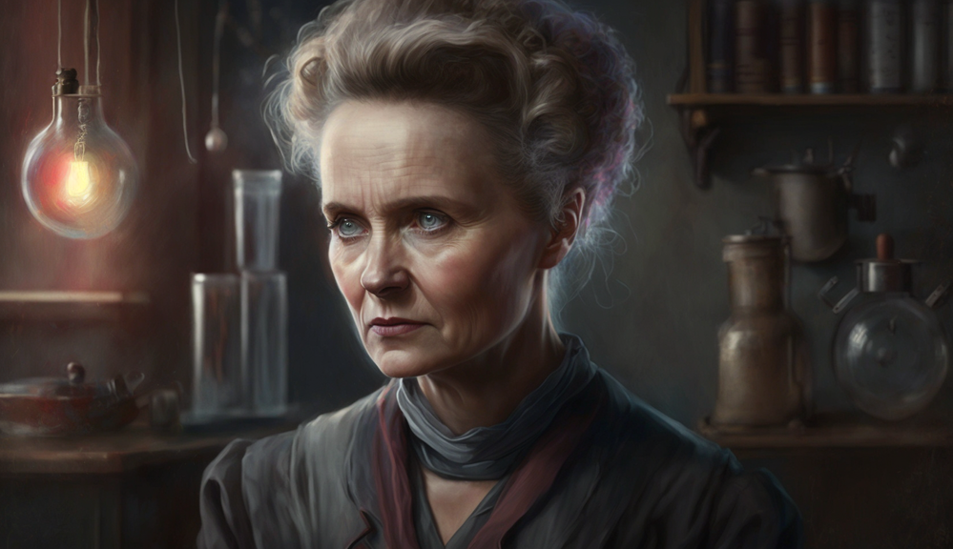
Marie Curie:
The Pioneering Physicist and Chemist
Marie Curie (1867-1934) was a Polish-born physicist and chemist who made groundbreaking discoveries in radioactivity. She became the first woman to win a Nobel Prize and remains the only person to have won Nobel Prizes in two different scientific fields: physics and chemistry.
Early Life and Education: Curie was born in Warsaw, Poland, to a family of teachers. Despite facing financial challenges and gender discrimination, she pursued her passion for science and moved to Paris to study at the Sorbonne. There, she met and married fellow scientist Pierre Curie, with whom she would collaborate on her groundbreaking research.
Discoveries and Nobel Prizes: In 1903, Marie Curie became the first woman to win a Nobel Prize when she shared the Physics prize with Pierre Curie and Antoine Henri Becquerel for their work on radioactivity. In 1911, she won her second Nobel Prize, this time in Chemistry, for her discovery of two new elements, polonium and radium. Curie's research in radioactivity laid the foundation for the development of nuclear science and medical applications such as cancer treatments.
Legacy and Challenges: Marie Curie's incredible accomplishments in science inspired future generations of female scientists to break barriers and pursue careers in traditionally male-dominated fields. However, Curie's work with radioactive materials also had negative consequences, as she was exposed to high levels of radiation throughout her career, ultimately leading to her death from complications related to radiation exposure.
Inquiry Questions:
How did Marie Curie's early life and education influence her passion for science and her pursuit of a career in research?
What were the key discoveries and accomplishments that led to Curie's Nobel Prizes in Physics and Chemistry?
How has Marie Curie's pioneering work in radioactivity impacted the fields of nuclear science and medicine?
What challenges did Curie face as a woman in science, and how did she overcome them to achieve her groundbreaking accomplishments?
How has Marie Curie's legacy as a pioneering physicist and chemist inspired future generations of scientists, particularly women in STEM fields?
Did You Know? Marie Curie was also the first woman to become a professor at the University of Paris and the first woman to be entombed in the Panthéon in Paris based on her own merits.

Slide 15
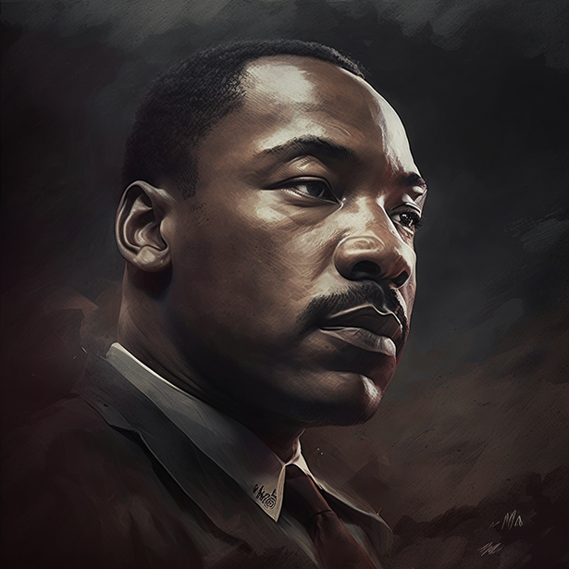
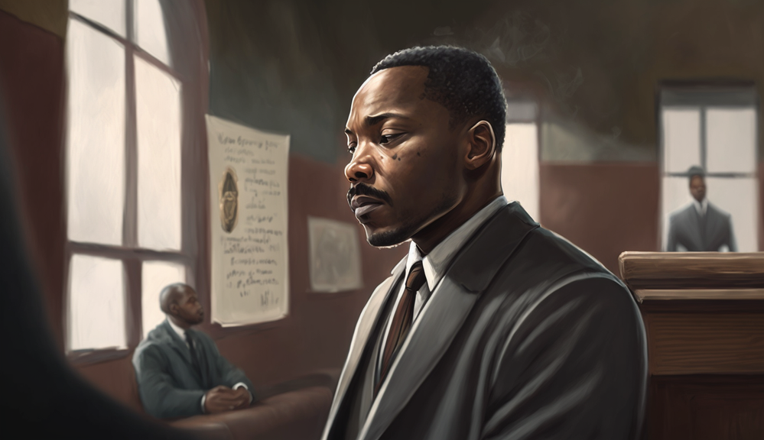
Martin Luther King Jr:
The Voice for Civil Rights and Racial Equality
Martin Luther King Jr. (1929-1968) was an American civil rights leader and Baptist minister who advocated for racial equality and the end of segregation in the United States. His powerful speeches, nonviolent protests, and unwavering commitment to the cause inspired millions in their fight for justice and equality.
Early Life and Education: King was born in Atlanta, Georgia, to a family of African American preachers. He excelled in his studies and attended Morehouse College, where he decided to become a minister. King later earned a doctorate in theology from Boston University, where he was exposed to the ideas of Mahatma Gandhi and developed his philosophy of nonviolent resistance.
Civil Rights Movement and Nonviolent Protests: In the 1950s and 1960s, King emerged as a prominent leader in the American civil rights movement. He played a crucial role in organizing and leading nonviolent protests, such as the Montgomery Bus Boycott and the Selma to Montgomery marches. King's leadership during the 1963 March on Washington, where he delivered his famous "I Have a Dream" speech, helped to bring national attention to the struggle for civil rights.
Assassination and Legacy: In 1968, Martin Luther King Jr. was tragically assassinated in Memphis, Tennessee. His death was a devastating blow to the civil rights movement, but his message of hope and his vision for a just and equal society continue to inspire generations to pursue racial equality and social justice.
Inquiry Questions:
How did Martin Luther King Jr.'s early life and education influence his commitment to civil rights and nonviolent resistance?
What role did King play in organizing and leading key events in the civil rights movement, such as the Montgomery Bus Boycott and the March on Washington?
How did King's philosophy of nonviolence and his powerful speeches galvanize support for the civil rights movement?
What impact did Martin Luther King Jr.'s assassination have on the civil rights movement and the fight for racial equality in the United States?
How has Martin Luther King Jr.'s legacy as a civil rights leader and voice for racial equality continued to inspire change throughout history?
Did You Know? In 1964, Martin Luther King Jr. was awarded the Nobel Peace Prize for his work in combating racial inequality through nonviolent means.

Slide 16
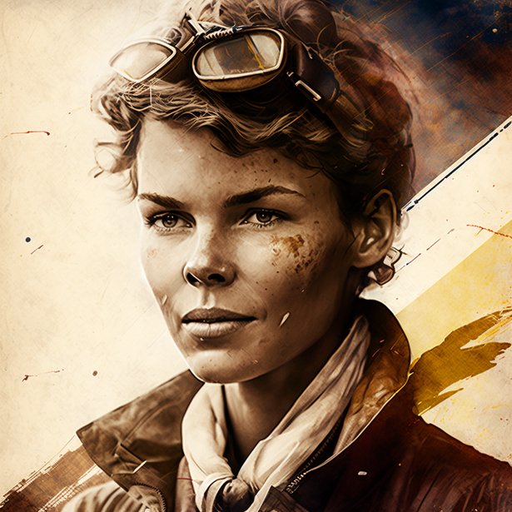

Amelia Earhart:
The Courageous Aviator Who Defied Boundaries
Amelia Earhart (1897-1937) was an American aviator who broke numerous records and became a symbol of courage and perseverance. As the first woman to fly solo across the Atlantic Ocean, Earhart inspired countless women to pursue careers in aviation and other male-dominated fields.
Early Life and Interest in Aviation: Earhart was born in Atchison, Kansas, and grew up with a sense of adventure and curiosity. After attending an air show in 1920, she developed a passion for flying and began taking flying lessons. In 1923, Earhart became the 16th woman in the United States to receive a pilot's license.
Record-Breaking Flights: Amelia Earhart's most famous flight occurred in 1932 when she became the first woman to fly solo across the Atlantic Ocean. This remarkable achievement earned her international fame and various awards, including the Distinguished Flying Cross. Earhart continued to break records, such as becoming the first person to fly solo across the Pacific Ocean from Honolulu to Oakland in 1935.
Final Flight and Disappearance: In 1937, Earhart embarked on her most ambitious challenge: an attempt to circumnavigate the globe. However, during the last leg of her flight, Earhart and her navigator, Fred Noonan, disappeared over the Pacific Ocean. Despite extensive search efforts, neither their plane nor their remains were ever found, leaving their fate a mystery.
Inquiry Questions:
How did Amelia Earhart's early life experiences and interest in aviation contribute to her groundbreaking accomplishments as a pilot?
What challenges did Earhart face as a woman in the male-dominated field of aviation, and how did she overcome them?
What were some of Amelia Earhart's most significant record-breaking flights, and how did they inspire future generations of aviators?
What theories have been proposed to explain the disappearance of Amelia Earhart and her navigator during their attempt to circumnavigate the globe?
How has Amelia Earhart's legacy as a courageous aviator and trailblazer for women in aviation continued to inspire people throughout history?
Did You Know? Amelia Earhart worked as a nurse's aide during World War I and later as a social worker before pursuing her passion for aviation.

Slide 17
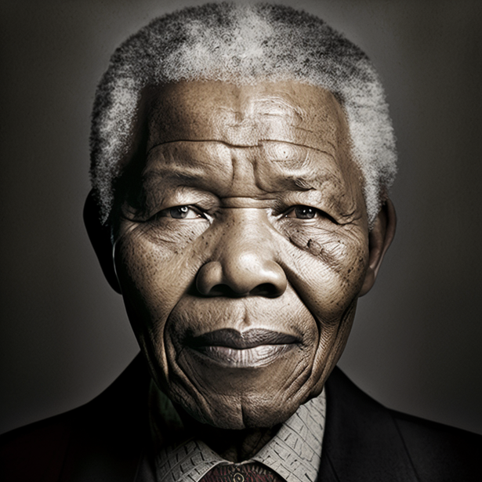
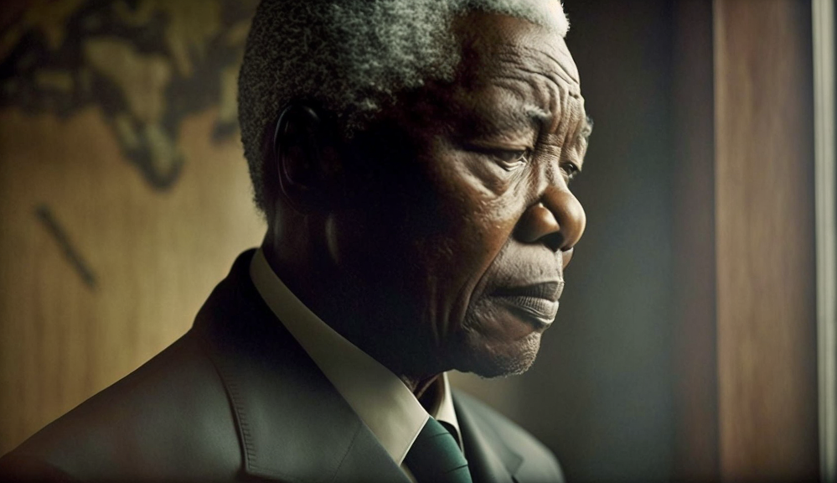
Nelson Mandela:
The Resilient Leader Who Fought for Freedom and Equality
Nelson Mandela (1918-2013) was a South African anti-apartheid activist, politician, and philanthropist who played a crucial role in dismantling apartheid and fostering racial reconciliation in South Africa. As the country's first black head of state, Mandela's leadership and resilience continue to inspire people worldwide.
Early Life and Political Involvement: Mandela was born in the Eastern Cape of South Africa into a royal family of the Thembu tribe. He studied law at the University of Witwatersrand, where he became involved in anti-apartheid activism. Mandela joined the African National Congress (ANC) in 1944 and later helped establish its armed wing, Umkhonto we Sizwe, in response to increasing state repression.
Imprisonment and Release: In 1962, Mandela was arrested and sentenced to life imprisonment for sabotage and conspiracy to overthrow the government. He spent 27 years in prison, primarily on Robben Island, enduring harsh conditions and hard labor. Despite his incarceration, Mandela remained a symbol of resistance and hope for millions of South Africans.
Presidency and Reconciliation: After his release from prison in 1990, Mandela led negotiations to dismantle apartheid and establish multiracial elections in South Africa. In 1994, he was elected the country's first black president, serving one term until 1999. As president, Mandela focused on reconciliation between the country's racial groups and oversaw the establishment of the Truth and Reconciliation Commission.
Inquiry Questions:
How did Nelson Mandela's early life experiences and political involvement shape his commitment to fighting apartheid and promoting racial equality?
What strategies and methods did Mandela employ in his struggle against apartheid before his imprisonment?
How did Mandela's 27-year imprisonment impact his personal life, his role in the anti-apartheid movement, and South Africa's political landscape?
What were the key initiatives and accomplishments of Mandela's presidency, particularly in fostering racial reconciliation and healing?
How has Nelson Mandela's legacy as a resilient leader and champion for freedom and equality continued to inspire people around the world?
Did You Know? Nelson Mandela was awarded the Nobel Peace Prize in 1993 for his role in ending apartheid and laying the foundations for a democratic South Africa.

Slide 18
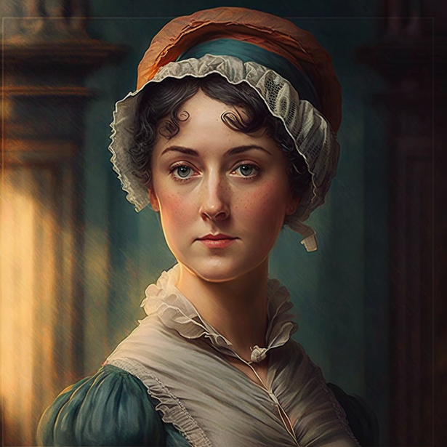
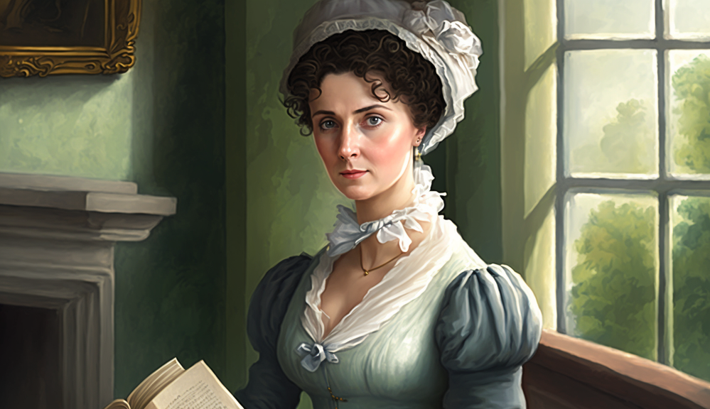
Jane Austen:
The Timeless Novelist
Jane Austen (1775-1817) was an English novelist known for her keen observations of society and her witty, insightful portrayals of human relationships. Her timeless novels, such as "Pride and Prejudice" and "Emma," have remained popular for over two centuries and continue to influence literature and popular culture.
Early Life and Writing: Austen was born in Hampshire, England, into a close-knit family with a love for reading and writing. She began writing stories and plays as a young girl, and by her early twenties, she had completed the original drafts of her most famous novels. Despite her talent, Austen initially struggled to find a publisher and did not achieve widespread recognition during her lifetime.
Major Works and Themes: Jane Austen's six major novels – "Sense and Sensibility," "Pride and Prejudice," "Mansfield Park," "Emma," "Northanger Abbey," and "Persuasion" – primarily focus on the lives of young women from the English gentry. Her novels explore themes such as love, marriage, social class, and self-discovery, offering sharp critiques of societal expectations and norms. Austen's unique narrative style, marked by irony and wit, has endeared her to generations of readers.
Legacy and Influence: Though Austen did not achieve great fame during her lifetime, her novels gained widespread popularity in the decades following her death. Today, she is considered one of the most important and influential authors in English literature. Austen's work has inspired numerous adaptations, spin-offs, and scholarly analyses, reflecting her enduring impact on popular culture and literary studies.
Inquiry Questions:
How did Jane Austen's early life experiences and family background influence her development as a writer and her perspectives on society?
What are the recurring themes and motifs in Austen's major works, and how do they reflect her views on love, marriage, and social class?
How does Austen's unique narrative style, characterized by irony and wit, contribute to the enduring appeal of her novels?
In what ways has Jane Austen's work influenced subsequent literature and popular culture, from adaptations to spin-offs and scholarly analyses?
How has Jane Austen's legacy as a timeless and insightful novelist continued to shape our understanding of human nature and society?
Did You Know? Jane Austen's authorship was initially kept a secret, with her first published novel, "Sense and Sensibility," attributed only to "A Lady."

Slide 19
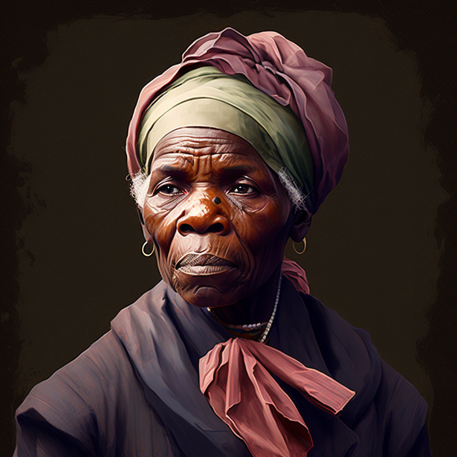
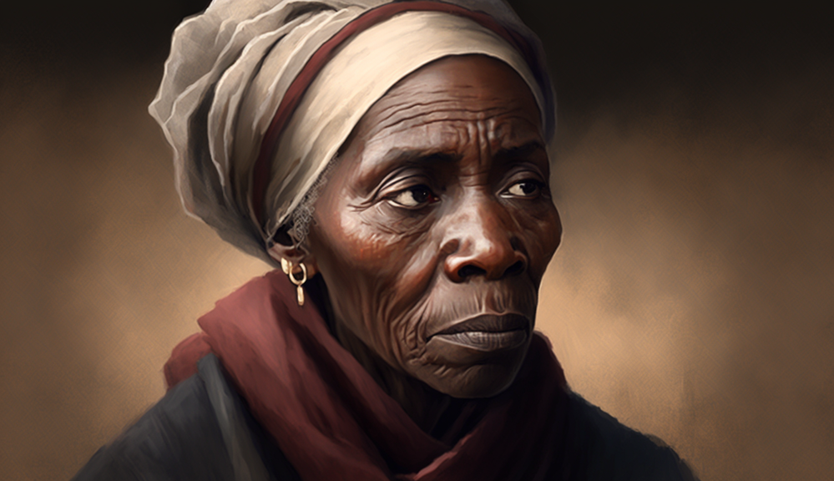
Harriet Tubman:
The Fearless Conductor of the Underground Railroad
Harriet Tubman (c. 1822-1913) was an African American abolitionist, humanitarian, and Union spy during the American Civil War. As a conductor on the Underground Railroad, Tubman risked her life to help hundreds of enslaved people escape to freedom, earning her the nickname "Moses."
Early Life and Enslavement: Tubman was born into slavery in Maryland and experienced a life of brutal treatment and hardship. After suffering a severe head injury as a teenager, Tubman experienced lifelong health issues, including seizures and visions, which she attributed to divine guidance.
Escape to Freedom and Underground Railroad: In 1849, Tubman escaped from slavery and made her way to Philadelphia. Despite the risks, she returned to Maryland multiple times to rescue her family members and other enslaved people. Using a network of safe houses and secret routes known as the Underground Railroad, Tubman led over 70 people to freedom.
Civil War and Later Life: During the Civil War, Tubman served as a nurse, scout, and spy for the Union Army. She was the first woman to lead an armed expedition in the war, helping to free over 700 enslaved people in the Combahee River Raid. After the war, Tubman settled in Auburn, New York, where she continued her work as an activist, suffragist, and humanitarian.
Inquiry Questions:
How did Harriet Tubman's early life experiences as an enslaved person influence her commitment to helping others escape slavery?
What were some of the key tactics and strategies that Tubman used to guide enslaved people to freedom through the Underground Railroad?
How did Tubman's role as a conductor on the Underground Railroad impact the abolitionist movement and the larger struggle against slavery?
In what ways did Harriet Tubman contribute to the Union cause during the Civil War, both as a military asset and a symbol of hope?
How has Harriet Tubman's legacy as a fearless abolitionist and humanitarian continued to inspire people throughout history?
Did You Know? Harriet Tubman is set to become the first African American woman to be featured on U.S. currency, with her portrait scheduled to appear on the redesigned $20 bill.

Slide 20
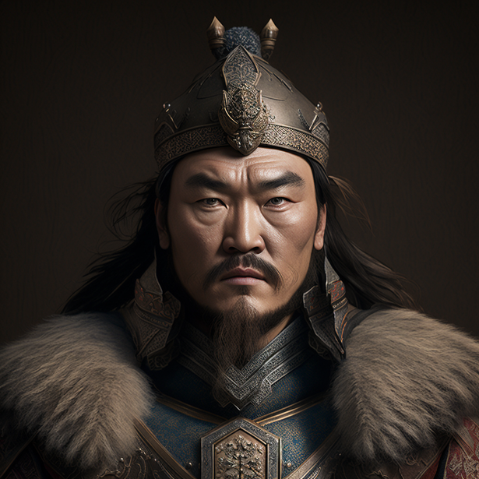
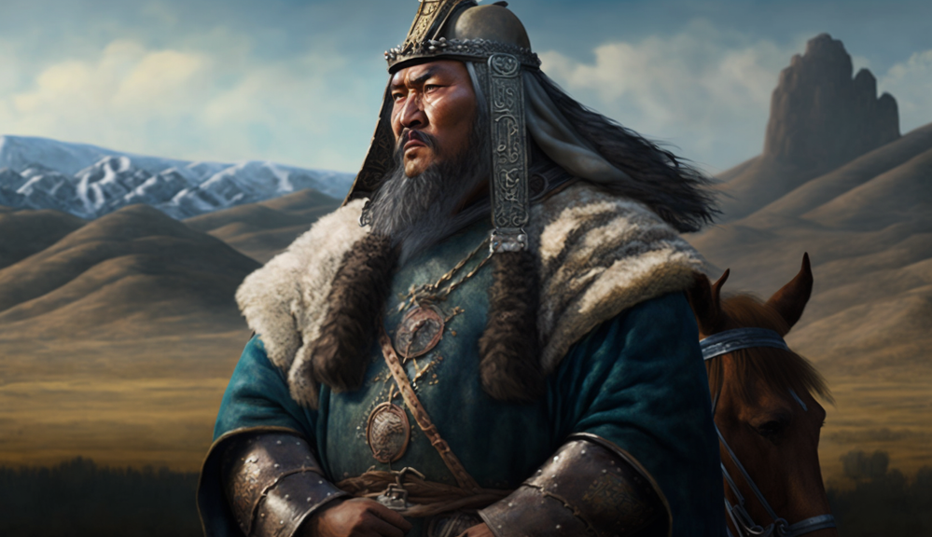
Genghis Khan:
The Fierce Warrior Who Created the Largest Contiguous Empire
Genghis Khan (c. 1162-1227), born as Temüjin, was the founder and first Great Khan of the Mongol Empire. Known for his military prowess and strategic genius, Genghis Khan's empire expanded across much of Asia, Europe, and the Middle East, leaving a lasting impact on world history.
Early Life and Rise to Power: Genghis Khan was born in the Mongolian Plateau, where tribal warfare and alliances were common. After the assassination of his father, a tribal leader, Genghis Khan endured a difficult childhood marked by poverty and exile. Displaying remarkable leadership skills, he steadily rose through the ranks and united the Mongol tribes under his rule.
Military Campaigns and Conquests: Genghis Khan's empire-building began with the invasion of the Western Xia and Jin dynasties in China. His military campaigns continued across Central Asia, the Middle East, and Eastern Europe, employing a mix of brutal tactics and diplomacy. His innovative military strategies and well-disciplined army made him one of history's most successful conquerors.
Administration and Legacy: Despite his reputation as a fierce warrior, Genghis Khan was also a skilled administrator. He established a legal code called the Yassa, which streamlined governance and promoted trade, communication, and cultural exchange within his vast empire. After his death, his descendants continued to expand the Mongol Empire, which eventually fragmented into various khanates.
Inquiry Questions:
How did Genghis Khan's early life experiences and challenges shape his development as a leader and conqueror?
What were some of the key military strategies and tactics employed by Genghis Khan and his army during their conquests?
How did Genghis Khan's conquests impact the societies, cultures, and economies of the territories he conquered?
What were the key principles of governance and administration within the Mongol Empire under Genghis Khan's rule?
How has Genghis Khan's legacy as a fierce warrior and empire-builder continued to influence world history and popular culture?
Did You Know? Genghis Khan promoted meritocracy within his ranks, often elevating common soldiers to positions of power based on their skills and loyalty rather than their lineage.

